Slide 1
Neural Implicit Surfaces for Variational Shape Modeling
Siqi Guo

Slide 2
Project Overview
Project Goal
Replicate and investigate the NeuVAS [Wang et al. 2025] (published on ACM Transactions on Graphics) method for creating 3D surfaces from sparse curve sketches
Why This Project
Research Interest: Combines differential geometry with deep learning
Practical Impact: Enables natural 3D modeling from VR/AR sketches
Technical Challenge: Hard to create a smooth surface passing through sparse curve sketches

Slide 3
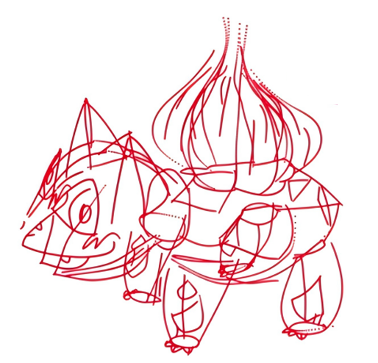
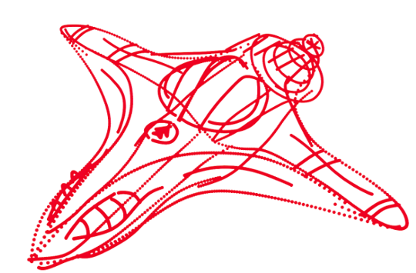
Surfacing Sparse 3D Curves
The Challenge: Given sparse, unstructured 3D curves, create a smooth surface that:
Accurately passes through the curves
Has natural, aesthetic shape in between
Preserves sharp features where intended
?
?
Huge gaps between curves - many possible surfaces

Slide 4
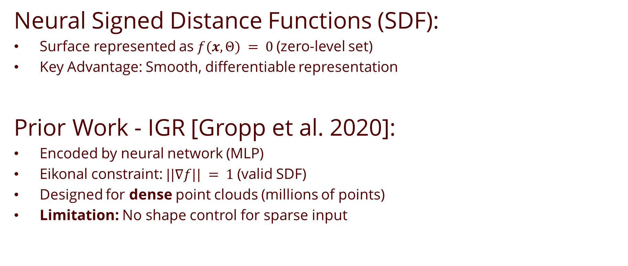
Foundation: What You Need to Know
Neural Signed Distance Functions (SDF):
Surface represented as $f(x,Θ) = 0$(zero-level set)
Key Advantage: Smooth, differentiable representation
Prior Work - IGR [Gropp et al. 2020]:
Encoded by neural network (MLP)
Eikonal constraint: $||∇f|| = 1$(valid SDF)
Designed for dense point clouds (millions of points)
Limitation: No shape control for sparse input

Slide 5
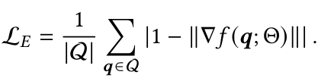



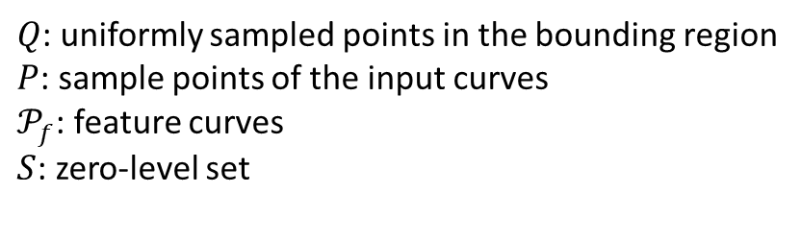

The Core Innovation
[Wang et al. 2025] NeuVAS Strategy: Combine thin-plate energy with neural SDF
Four-Part Loss Function
Eikonal Condition.
Dirichlet Manifold.
Dirichlet Non-Manifold
Distance-Weighted Smoothness (based on the thin-plate energy)
$Q$: uniformly sampled points in the bounding region
$P$: sample points of the input curves
$𝒫_{f}$: feature curves
$S$: zero-level set
Makes $f$ behave like distance function
On-Curve Constraint
Avoids $f(x) = 0$everywhere - prevent Trivial Solution
Near features: weight ≈ 0 → no penalty for bending

Slide 6
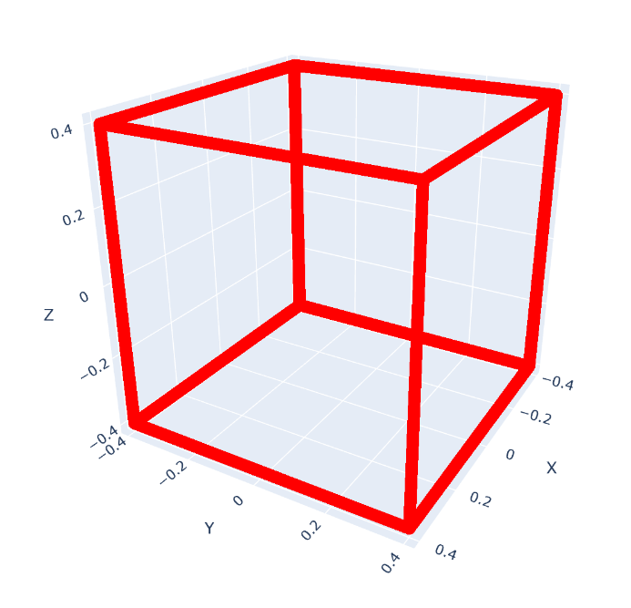
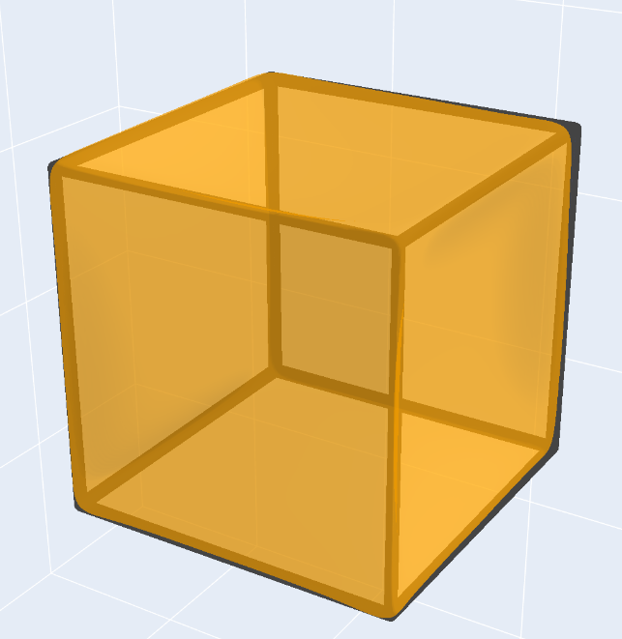
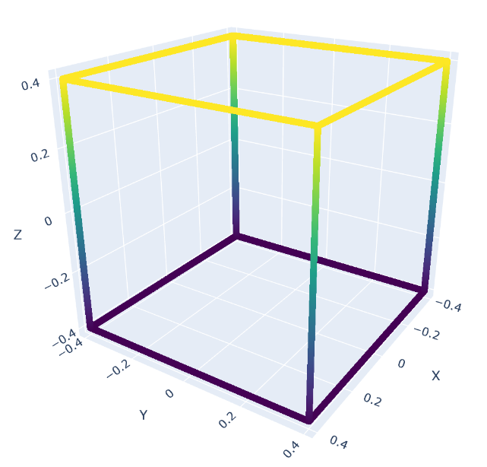
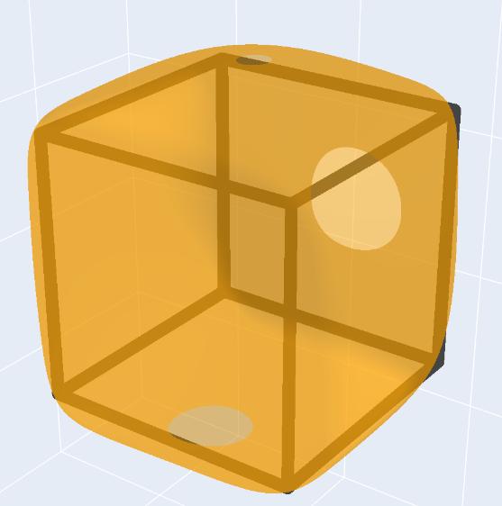
Smoothness Energy
with feature curves
without feature curves

Slide 7

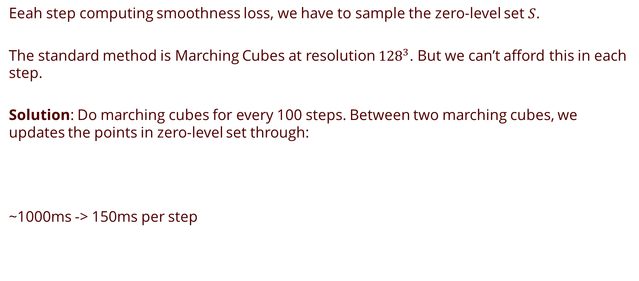
Key Acceleration
Eeah step computing smoothness loss, we have to sample the zero-level set $S$.
The standard method is Marching Cubes at resolution ${128}^{3}$. But we can’t afford this in each step.
Solution: Do marching cubes for every 100 steps. Between two marching cubes, we updates the points in zero-level set through:
~1000ms -> 150ms per step

Slide 8
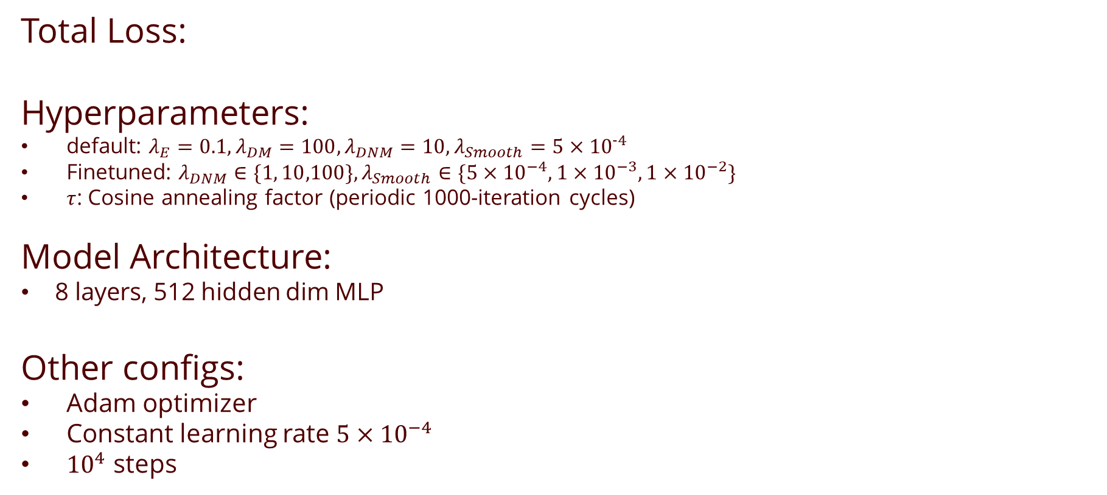
Putting It All Together
Total Loss:
Hyperparameters:
default: $λ_{E}=0.1,λ_{DM}=100,λ_{DNM}=10,λ_{Smooth}=5×{10}^{−4}$
Finetuned: $λ_{DNM}∈\{1, 10,100\},λ_{Smooth}∈\{5×{10}^{−4},1×{10}^{−3},1×{10}^{−2}\}$
$τ$: Cosine annealing factor (periodic 1000-iteration cycles)
Model Architecture:
8 layers, 512 hidden dim MLP
Other configs:
Adam optimizer
Constant learning rate $5×{10}^{−4}$
${10}^{4}$ steps

Slide 9
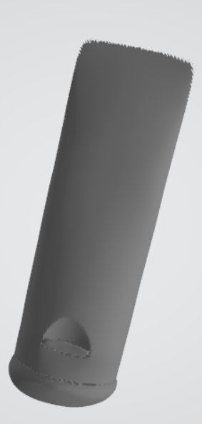
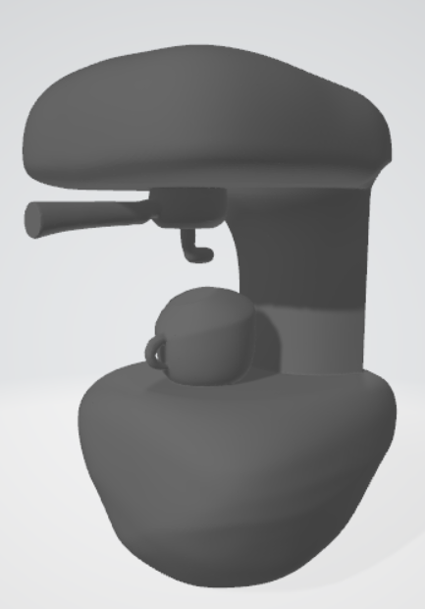
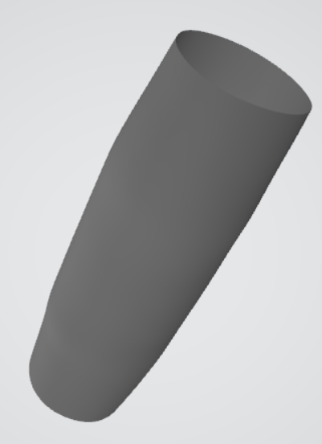
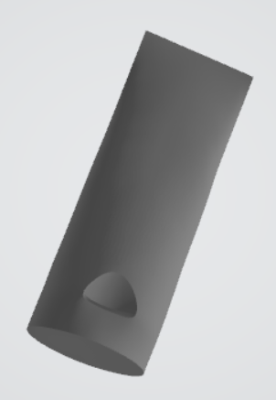
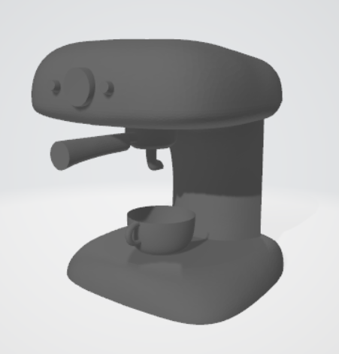
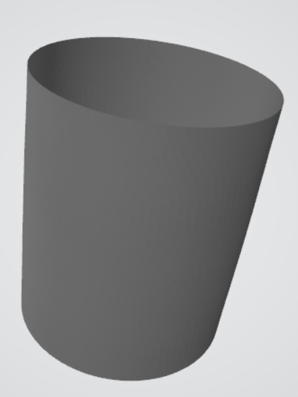
Results: Structured Curve Networks
IGR [Gropp et al. 2020]:
NeuVAS Replicated:
toothpaste
espresso
cylinder

Slide 10
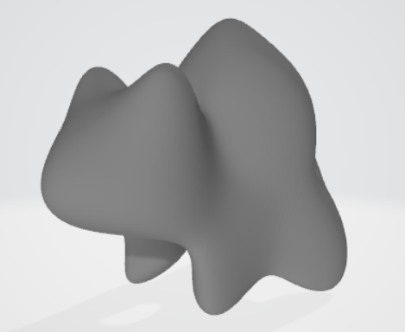
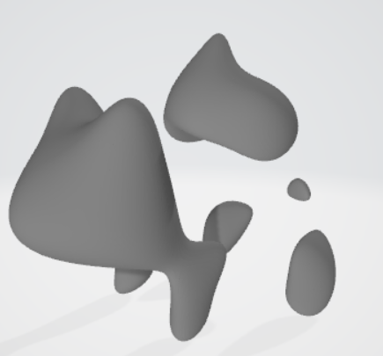
Results: Disconnected Curve Sketches
Bulbasaur: the surfaces are always degenerated to multi-parts.
step 2500
Step 3000

Slide 11
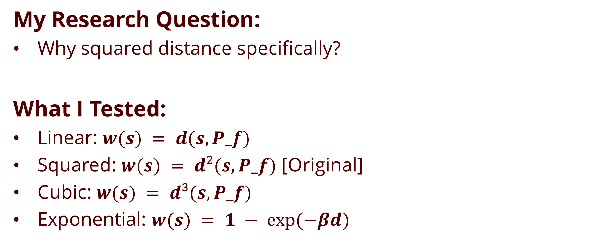
Investigating Design Choices
My Research Question:
Why squared distance specifically?
What I Tested:
Linear: $w(s) = d(s, P_f)$
Squared: $w(s) = d²(s, P_f)$ [Original]
Cubic: $w(s) = d³(s, P_f)$
Exponential: $w(s) = 1 − exp⁡(−βd)$

Slide 12
Project Summary
What I Accomplished:
Partial replication of NeuVAS from paper.
Hyperparameters Optimization
(NeuVAS is extremely sensitive to hyperparameters)
Future Works:
Improve the run-time performance

